Slide 1





EduGen – Dynamic Learning Resource Synthesizer
AI-driven content creation for personalized, engaging, and efficient learning

Slide 2






MEET OUR
Project team
SAHIL KARNE
SACHIN JADHAV
YASH GUNJAL
OM BHUTKAR
ARYAN TAMBOLI
MRS.SAVITA MANE
202201040086
202201040080
202201040106
202201040111
202201040088
Project Guide

Slide 3



CONTENT INDEX
Introduction
Compact Evaluation Comparison Table
Problem Statement
Ethical Considerations
Objectives
System Design
Dataset Selection
Mathematical Formulation
Literature Review
Real-World Applications
Model Selection & Description
Conclusion
Future Scope

Slide 4


Introduction
Education today faces challenges of generic, text-heavy, and one-size-fits-all content.
Students often need personalized notes, practice sets, and visuals that match their syllabus and learning pace.
EduGen addresses this by using Generative AI to automatically create summaries, question banks, diagrams, and illustrations.
The system integrates 4 GenAI models (Autoencoders, GANs, Transformers, Diffusion) → each handling a different type of content.
Ensures adaptability, accessibility, and engagement for learners across levels.
Supports self-learning, exam preparation, and classroom teaching.

Slide 5
Problem Statement
Students face a lack of personalized, engaging, and syllabus-specific study materials; existing resources are generic, text-heavy, and fail to adapt to individual learning needs.

Slide 6
Objectives
To design and implement an AI-powered study resource synthesizer.
To integrate Autoencoders, GANs, Transformers, and Diffusion models for multi-modal content generation.
To create concise summaries, diverse question banks, simplified diagrams, and STEM illustrations automatically.
To ensure personalized content delivery based on grade level, syllabus, and learner preferences.
To make learning more accessible, engaging, and exam-oriented.
To improve time efficiency by reducing manual note-making and question preparation.
To provide a scalable solution that can be adapted for schools, universities, and competitive exams.
To explore the potential of Generative AI in sustainable and inclusive education.

Slide 7



Dataset Selection
DATASET SELECTION
Chosen Dataset: ScienceQA (Multimodal Dataset for STEM Learning)
Features:
Contains 21,208 questions across science subjects (physics, chemistry, biology, earth science).
Multimodal inputs → questions, detailed answers, explanatory text, and diagrams/images.
Covers elementary to high school grade levels.
Why Selected for EduGen:
Provides both textual (questions, explanations) and visual content (diagrams) → aligns with EduGen’s goal of generating summaries, Q-banks, and illustrations.
ScienceQA Dataset Link

Slide 8
Literature
Survey

Slide 9
Serial No | Title | Year | Description | Ideas Extracted
1 | Diffusion Models: From Theory to Practice in Generative AI | 2025 | Survey explaining theory, mathematics, applications and acceleration of diffusion models like DDPM, DDIM, LDM, classifier-free guidance, distillation. | Diffusion vs GANs Latent diffusion & text-to-image Improved sampling & efficiency methods Integration with LLMs for multimodal AI
2 | Sampling Efficiency & Acceleration in Diffusion Models | 2024 | Comprehensive review of GAN models, their architecture, variants, evaluation, and applications in healthcare, finance, remote sensing, marketing, etc. | GAN variants (cGAN, WGAN, CycleGAN) Applications in multiple industries Training challenges like mode collapse Future scope in time-series, medicine
3 | A Comprehensive Study of Autoencoders for Anomaly Detection: Efficiency and Trade-offs | 2024 | Systematic review of 11 autoencoder architectures for anomaly detection, evaluated for reconstruction, latent space modeling, reproducibility. | AE, VAE, and generative variants compared Importance of reconstruction error Used MNIST/Fashion-MNIST Highlights trade-offs in stability & performance

Slide 10
Serial No | Title | Year | Description | Ideas Extracted
4 | GPT — A Comprehensive Review on Enabling Technologies, Potential Applications, Emerging Challenges, and Future Directions | 2024 | This paper presents a detailed overview of GPT models, including transformer architecture, training pipeline, applications, challenges, and future research directions. | GPT architecture and evolution Applications in NLP, health, banking, etc. Self-attention benefits Challenges: bias, data privacy, compute requirements
5 | Unleashing the Potential of PIM: Accelerating Large Batched Inference of Transformer-Based Generative Models | 2023 | Focuses on accelerating large-scale transformer inference using Processing-in-Memory (PIM) architecture, proposed system AttAcc improves GPT inference efficiency. | KV-cache bottleneck identification PIM-based acceleration Improved throughput and lower energy use for GPT inference
6 | Diffusion Models in Vision: A Survey | 2023 | Survey of denoising diffusion models including DDPM, SDE-based diffusion, and applications like image generation, segmentation, anomaly detection. | Diffusion vs. GANs, VAEs Two-phase diffusion & reverse noise process Applications: super-resolution, inpainting, editing Challenges: slow sampling

Slide 11
Serial No | Title | Year | Description | Ideas Extracted
7 | Sampling Efficiency & Acceleration in Diffusion Models | 2023 | This work explores techniques to accelerate diffusion model sampling using improved denoising strategies, reduced timestep schedules, and optimization methods like DDIM and model distillation to reduce inference time. | Faster diffusion sampling methods DDIM sampling Distillation reduces steps Real-time generative efficiency
8 | GPT — A Comprehensive Review on Enabling Technologies, Applications & Future Directions | 2023 | This paper provides a detailed overview of GPT architecture, transformer workflows, use cases across industries, and discusses challenges like ethical risks, model bias, and computational limitations. | GPT architecture & training Applications in NLP & real-world systems Limitations: bias, privacy, hallucinations Future improvements in efficiency & safety
9 | A Comprehensive Study of Autoencoders for Anomaly Detection | 2022 | This paper Autoencoder models for image-based anomaly detection and compares reconstruction accuracy, latent representation quality, robustness, and reproducibility issues. | Classical AE, DAE, VAE comparison Reconstruction error as anomaly metric Latent space analysis Trade-offs: speed vs. accuracy

Slide 12
Serial No | Title | Year | Description | Ideas Extracted
10 | GANs and Their Applications Across Diverse Fields | 2022 | Surveys GAN variants (DCGAN, WGAN, CycleGAN) and their applications in medicine, remote sensing, climate modeling, image enhancement, and finance. | GAN variants for domain-specific tasks Image-to-image translation Mode collapse challenges Wide applicability across industries
11 | Processing Key/Value Cache Bottlenecks in Large Transformers | 2022 | Identifies KV-cache memory limitations in long-sequence transformer inference and highlights architectural bottlenecks affecting attention computation and throughput. | KV-cache growth issue Memory–compute imbalance Long-sequence inefficiency Need for hardware-level optimization
12 | WGAN and Wasserstein Distance for Stable GAN Training | 2017–2024 (widely cited) | Discusses how Wasserstein distance improves GAN stability by addressing vanishing gradients and mode collapse through Lipschitz constraints and critic optimization. | Wasserstein distance Solving mode collapse Stable discriminator training Higher-quality image generation

Slide 13



Model Selection & Description
EduGen integrates 4 Generative AI Models into one pipeline.
Each model contributes to a specific type of learning content.
Autoencoders (VAE) → simplify and reconstruct diagrams.
GANs → generate diverse question banks
Transformers (BERT, T5, GPT) → summarize chapters & create notes/flashcards.
Diffusion Models (Stable Diffusion, DALL·E) → produce STEM illustrations from text prompts.

Slide 14
1.
Autoencoders / Variational Autoencoders (VAE)
Application in EduGen:
Compress and reconstruct diagrams from textbooks.
Convert complex engineering/physics diagrams into simplified schematics for students.
Why Chosen:
Efficient diagram handling → lower storage, faster sharing, clearer visuals.
Example :
Transformer coil diagram simplified into a student-friendly schematic.

Slide 15
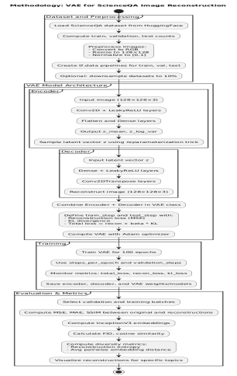
Methodology

Slide 16
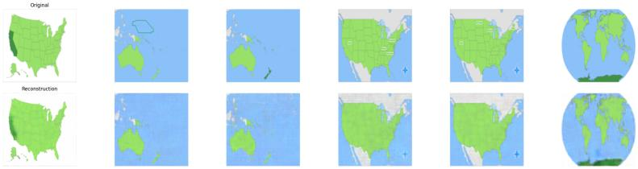
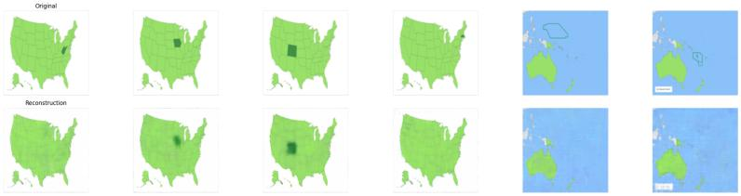
Output
1.

Slide 17
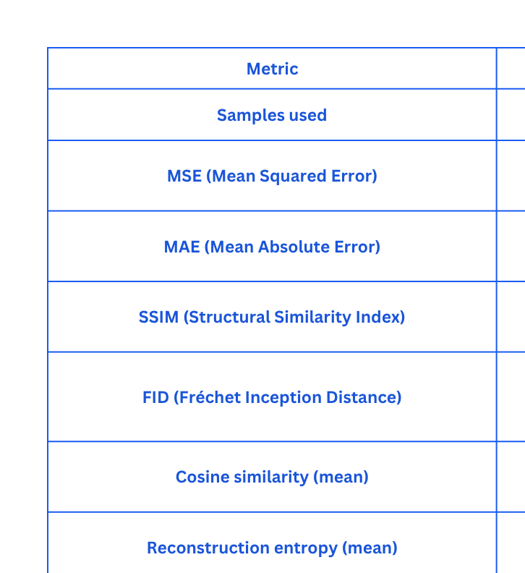
Evaluation Metrics

Slide 18
2.
Generative Adversarial Networks (GANs)
Application in EduGen:
Generate diverse question banks (MCQs, descriptive).
Produce labeled diagrams for visual subjects.
Why Chosen:
GANs ensure diversity and originality in generated practice sets.
Example :
For Faraday’s Law → 5 MCQs + 2 descriptive + 1 labeled diagram of magnetic field lines.

Slide 19
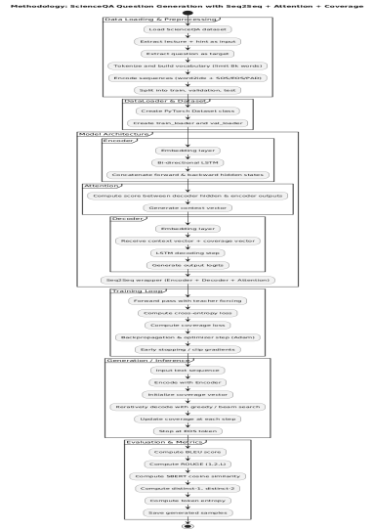
Methodology

Slide 20
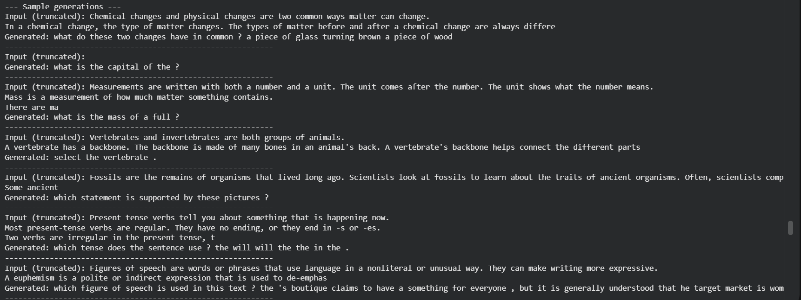
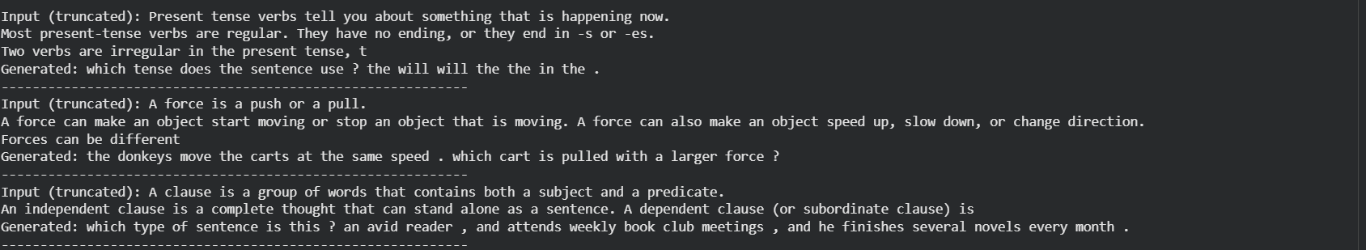
Output

Slide 21
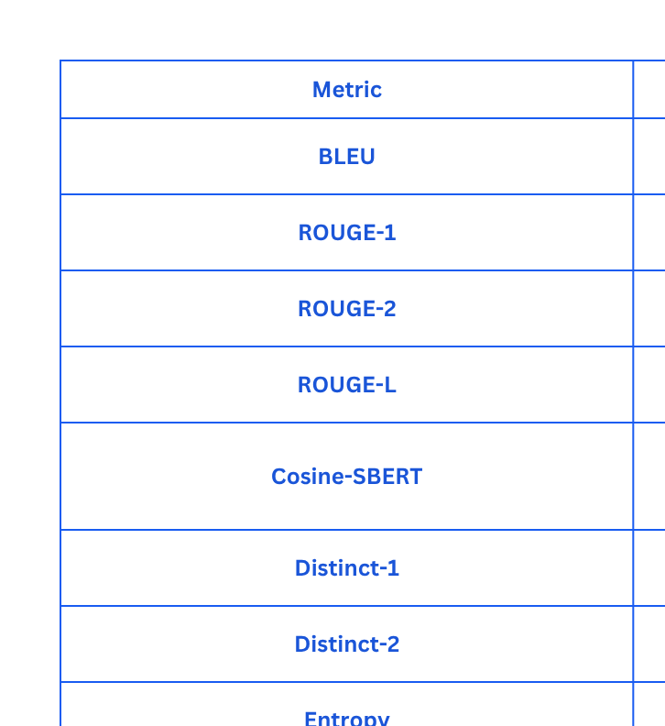
Evaluation Metrics

Slide 22
3.
Transformer-Based Models (BERT, T5, GPT)
Application in EduGen:
Summarize chapters into concise notes.
Generate personalized flashcards and explanations.
Why Chosen:
Transformers excel in NLP → accurate, grade-level appropriate content.
Example :
Dense Maxwell’s Equations → simplified 5-point summary in easy English.

Slide 23
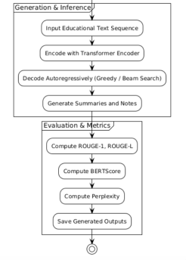
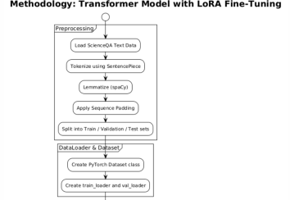
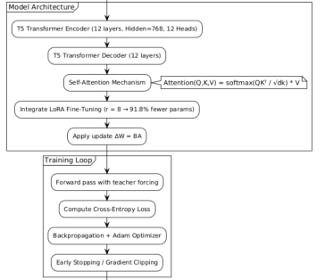
Methodology

Slide 24
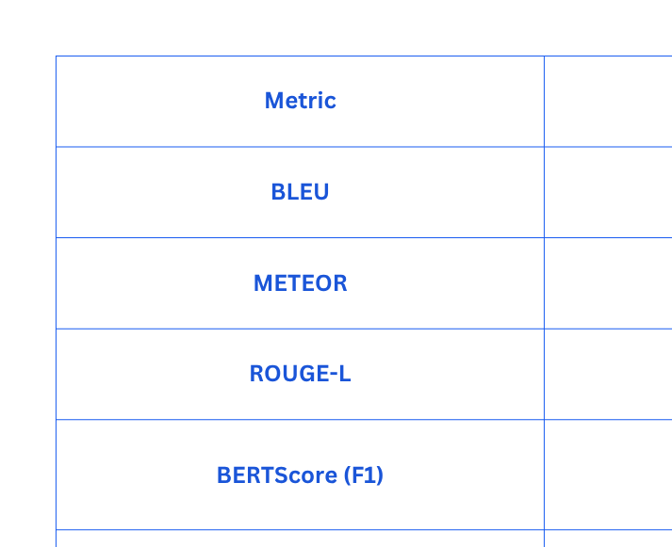
Evaluation Metrics

Slide 25
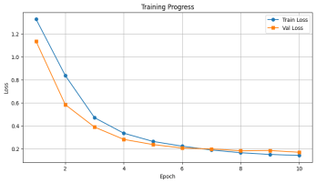
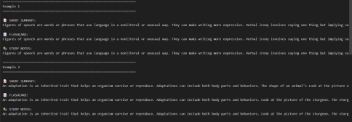
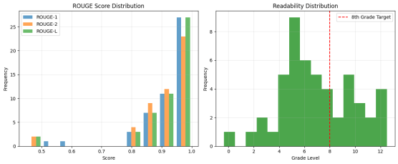
Output

Slide 26
4.
Diffusion Models (Stable Diffusion, DALL·E)
Application in EduGen:
Generate STEM illustrations from text prompts.
Provide high-quality, photorealistic or schematic concept visuals.
Why Chosen:
Makes abstract topics intuitive and visually clear.
Example :
Prompt → “3D copper coil with AC current & magnetic field lines” → detailed illustration.

Slide 27
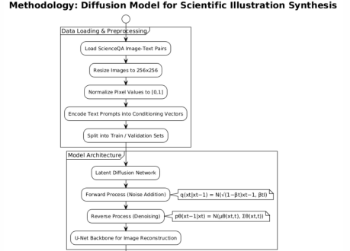
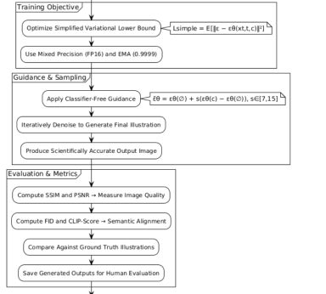
Methodology

Slide 28
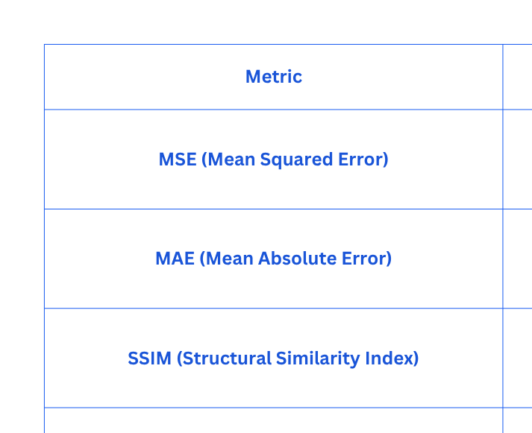
Evaluation Metrics

Slide 29
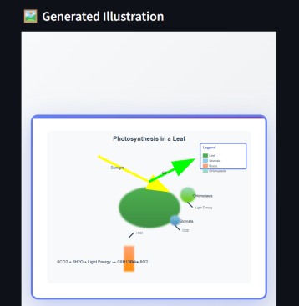
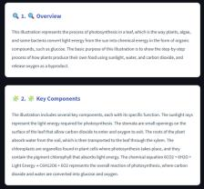
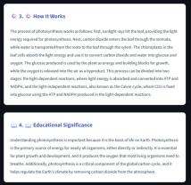
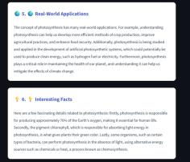
Output

Slide 30
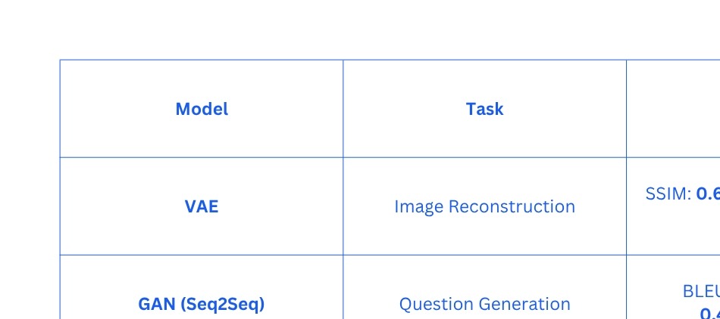
Comparison of Evaluation Metrics

Slide 31
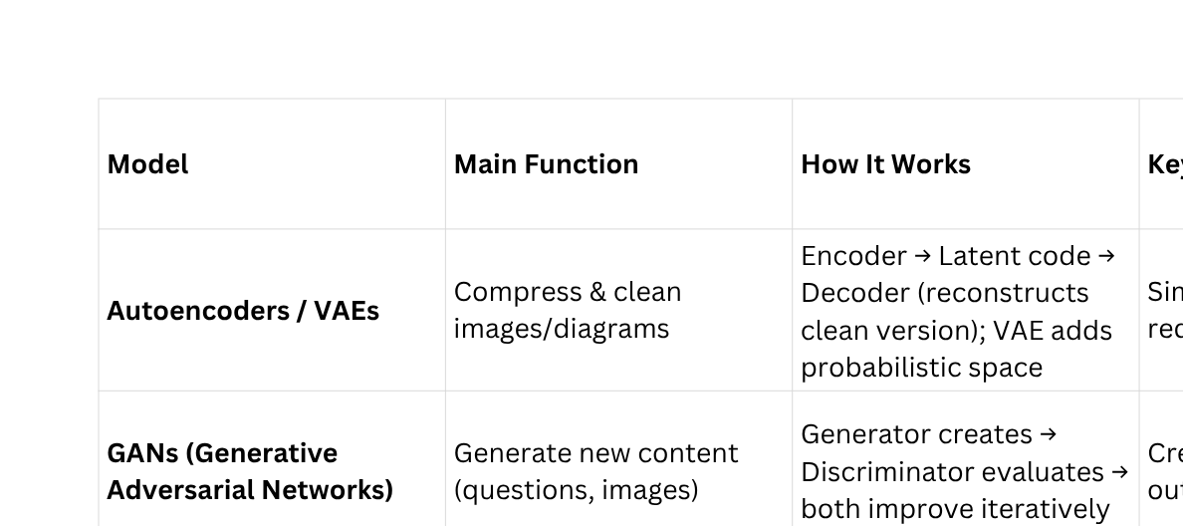
Comparative Analysis

Slide 32
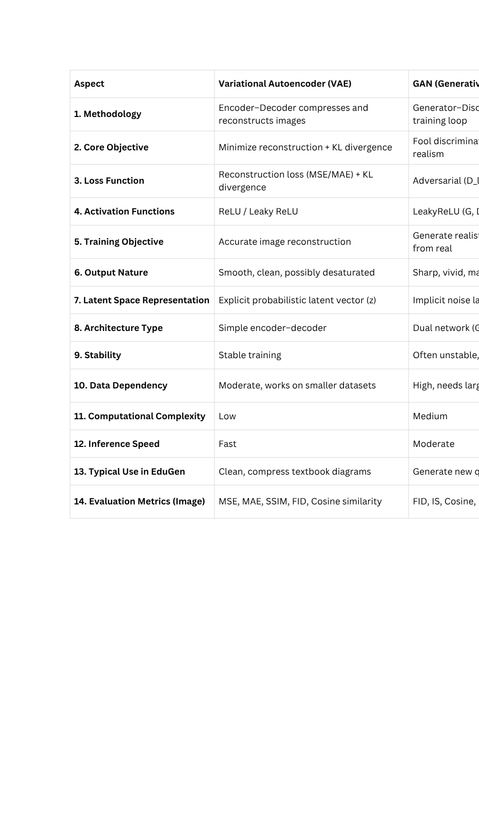
Comparative Analysis

Slide 33
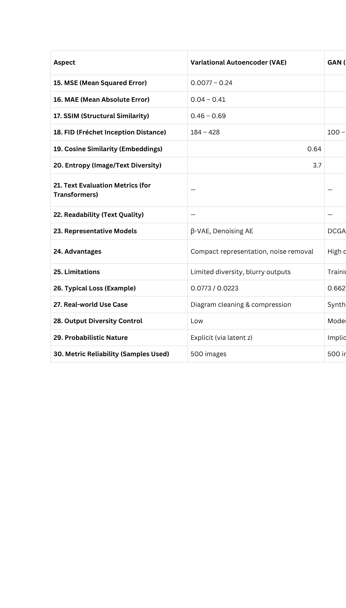
Comparative Analysis

Slide 34
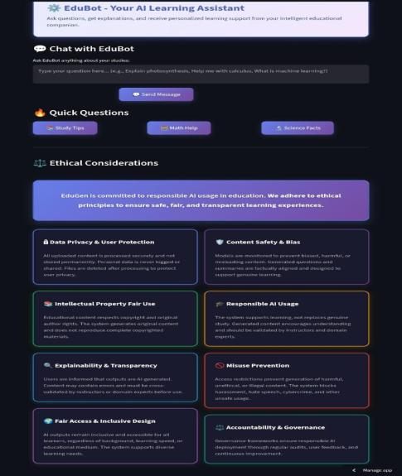
Ethical Consideration
EduBot is designed as a responsible AI learning assistant that prioritizes safe, fair, and transparent educational support. It follows strong ethical principles to ensure learners receive accurate and meaningful guidance.
1. Data Privacy & User Protection
User data is processed securely and not stored permanently.
2. Content Safety & Bias Control
AI outputs are monitored to avoid harmful, biased, or misleading content.
3. Intellectual Property Fair Use
Generates original content without copying copyrighted material.
4. Responsible AI Usage
AI supports learning but does not replace genuine study; outputs should be validated.
5. Explainability & Transparency
Users are told content is AI-generated and may require review for accuracy.
6. Misuse Prevention
System blocks harmful, illegal, or unethical requests and unsafe behavior.
7. Fair Access & Inclusive Design
Designed to remain accessible to all learners regardless of background or ability.
8. Accountability & Governance
Regular audits, feedback, and monitoring ensure responsible AI performance.

Slide 35


System UMLO
Autoencoders
GANs
Transformer
Diffusion Models
Input
preprocessing
Output
Integrate

Slide 36
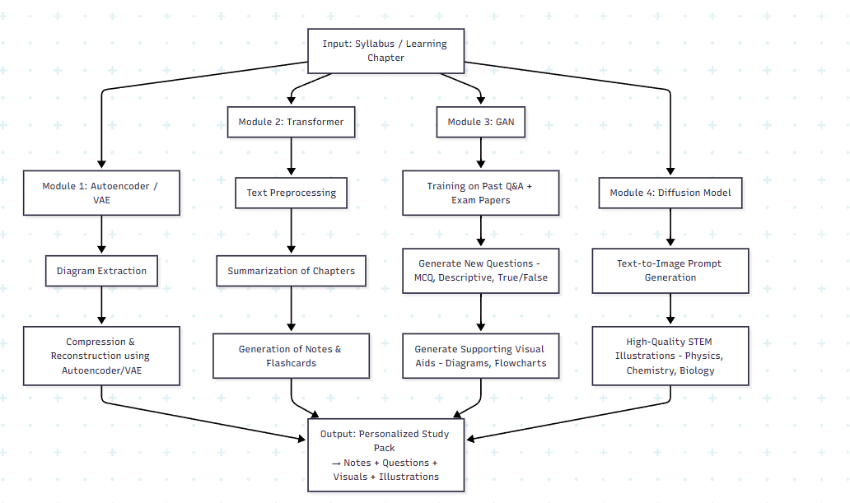
System Design

Slide 37
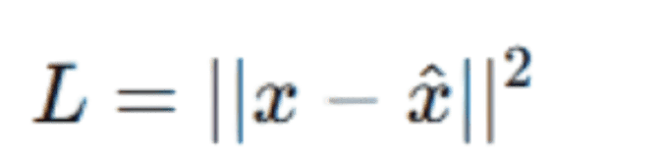

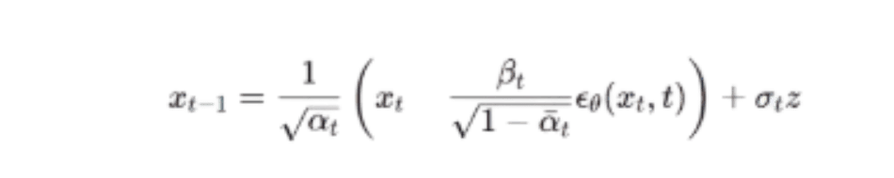
Mathematical Formulation
Autoencoder Loss:
GAN Loss:
Autoencoder Loss:
Diffusion Step

Slide 38

Real-World Applications
EdTech Platforms
Integration into e-learning apps for personalized study material.
Rural & Under-resourced Schools
Auto-generated notes, diagrams, and Q-banks without expert teachers.
Competitive & Board Exam Preparation
Customized practice sets and summaries for NEET, JEE, UPSC, CET.
Special Learning Needs
Adaptive content for slow/fast learners and students with visual learning preferences.
Corporate & Professional Training
Tailored content packs for employee skill upskilling.

Slide 39

Conclusion
EduGen is an AI-powered personalized study pack generator designed to revolutionize the way students access and engage with learning materials. By combining four powerful Generative AI models—Autoencoders, GANs, Transformers, and Diffusion models—the system is capable of producing concise summaries, diverse question banks, simplified diagrams, and high-quality illustrations that are tailored to individual learners’ needs. This integration not only ensures personalized and adaptive content delivery but also enhances student engagement, accessibility, and exam readiness, making EduGen a promising solution for modern education and self-learning.

Slide 40
References
Xu, M., et al. (2025). GenAIReading: Towards Generative Reading Comprehension via LLM and Image Generation. arXiv:2502.13271.
Sharma, A., et al. (2025). SocratiQ: Personalized Socratic Teaching via Generative AI. arXiv:2502.19437.
Frontiers in Education (2024). Dynamic Personalization of Learning with ChatGPT: Lessons Learned from Two Case Studies. DOI: 10.3389/feduc.2024.1337349.
Wang, C., et al. (2025). Personalized Knowledge Transfer in Education with Generative AI. arXiv:2502.19356.
Goodfellow, I., Pouget-Abadie, J., et al. (2014). Generative Adversarial Nets. Advances in Neural Information Processing Systems (NeurIPS).
Kingma, D. P., & Welling, M. (2013). Auto-Encoding Variational Bayes. arXiv:1312.6114.
Vaswani, A., et al. (2017). Attention is All You Need. NeurIPS.
Ho, J., Jain, A., & Abbeel, P. (2020). Denoising Diffusion Probabilistic Models. NeurIPS.

Slide 41
Thank You..!!
Any questions?

